Slide 1
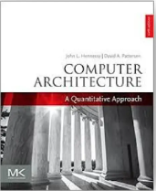
Computer Architecture
A Quantitative Approach
Chapter 2 and Appendix B
Virtual Memory

Slide 2
VIRTUAL MEMORY
- APPENDIX B / CHAPTER 2

Slide 3
Virtual addressing
Computers are designed so that multiple programs can be active at the same time
At the time a program is compiled, the compiler must assign addresses to each data item. But how can it know what memory addresses are being used by other programs?
Instead, the compiler assigns virtual addresses, and expects the loader/OS to provide the means to map these into physical addresses

Slide 4
In the olden days …
The loader would locate an unused set of main memory addresses and load the program and data there
There would be a special register called the relocation register, and all addresses that the program used would be interpreted as addresses relative to the base address in that register
So, if the program jumped to location 54, the jump would really be to 54 + contents of relocation register.
A similar thing, perhaps with a second register, would happen for data references
Notes:
>>
In the olden days …
…

Slide 5
In the less-olden days ...
It became difficult to find a contiguous segment of memory big enough to hold program and data.
So, the program was divided into pages, with each page stored contiguously, but different pages in any available spot, either in main memory or on disk
This is the virtual addressing scheme
– to the program, memory looks like a contiguous segment, but data is scattered in main memory and perhaps on disk
Notes:
In the less-olden days …
…
Virtual addressing involves the separation of logical memory as perceived by developers from physical memory.
The separation allows logical address space to be much larger than physical address space.
The virtual address space of a process refers to the logical view of how process is stored in memory.

Slide 6
Memory protection
Each program “lives” in its own virtual space,
called its process
When the CPU is working on one process, others may be partially completed or waiting for attention
The CPU is time shared among the processes, working on each in turn
And main memory is also shared among processes
Notes:
>>
Each program runs (“lives”) as an independent instance known as a process,
which operates within its own isolated virtual memory space,
which gives the illusion of exclusive access to the entire memory address space.
When the CPU is actively executing instructions for one process,
other processes may be in various states such as waiting for I/O operations,
ready to run, or partially completed, awaiting their next turn.
The OS manages this by time-sharing the CPU among all active processes,
allocating short time slices to each in a rapid, interleaved manner,
which creates the perception of simultaneous execution.
Main memory is also managed to ensure isolation;
each process has its own dedicated virtual memory space,
Which prevents processes from interfering with each other's data,
maintaining system stability and security.

Slide 7
But we know all about this!
Already know that a program and data can be scattered between cache memory and main memory
Now add the reality that its location in main memory is also determined in a scattered way, and some pages may also be located on disk
So, each page has its own unique virtual address or virtual page number
Notes:
>>
A program and its data are
managed across multiple memory levels,
(including cache, main memory, and disk,)
with their physical locations being scattered.
Main memory is divided into fixed-size pages,
and these pages can be mapped to non-contiguous physical locations,
meaning a single program's data may reside in different,
scattered pages throughout main memory.
Furthermore, when main memory is insufficient,
the OS may swap out less frequently used pages to disk storage.
Each page has a unique virtual address,
and (a hardware component known as) the memory management unit (MMU)
translates these virtual addresses into physical addresses
using a relocation value.
This process is known as memory mapping or address translation.
For reference:
A Memory Management Unit (MMU) is a hardware component
responsible for translating virtual memory addresses into physical addresses
and enforcing memory protection to isolate processes and the OS.

Slide 8
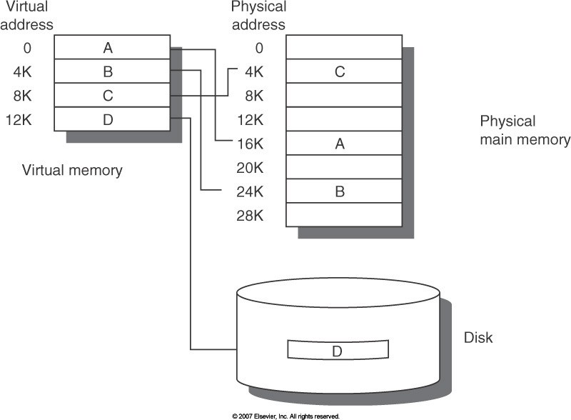
Virtual Memory (Figure B.19)
Notes:
>>
This figure shows the mapping of virtual memory to physical memory for a program with four pages.
The virtual address space on the left consists of pages: A, B, C, and D.
The actual location of three of the blocks is in physical main memory
and the other is located on the disk as shown on the right.

Slide 9
Parameters (Figure B.20)
(2011 view)
Parameter | First-level cache | Virtual memory
Block (page) size | 16-128 bytes | 4096-65,536 bytes
Hit time | 1-3 clock cycles | 100-200 cc
Miss penalty | 8-200 cc | 10⁶-10⁷ cc
(access time) | (6-160 cc) | (.8-8)*10⁶ cc
(transfer time) | (2-40 cc) | (.2-2)*10⁶ cc
Miss rate | 0.1-10% | 0.00001-0.001%
Address mapping | 25-45 bit physical address to 14-20 bit cache address | 32-64 bit virtual address to 25-45 bit physical address
Notes:
>>
The table shows a typical range of memory hierarchy parameters for caches and virtual memory.
Virtual memory parameters represent increases by 10 to 1,000,000 times over cache parameters.
Optional:
Normally, first-level caches contain at most 1 MB of data,
whereas physical memory contains 256 MB to 1 TB.

Slide 10
Cache vs. virtual memory
Cache | Virtual memory
Cache miss handled by hardware | Page faults handled by OS
Cache size fixed for a particular machine | Virtual memory size fixed for a particular program
Fundamental unit is a block | Fundamental unit is a fixed-length page or a variable-length segment
cache miss | page fault (or address fault)
Notes:
>>
Replacement on a cache miss is primarily controlled by hardware.
While page replacement in virtual memory is primarily controlled by the OS.
Cache size is fixed for a particular machine.
Virtual memory size is determined by both
the system's architecture
and the available virtual address space,
which is typically defined by the number of bits in the address
(which is fixed by the time a program executes)
Fundamental unit is a …
A cache miss occurs when the requested data is not found in the CPU cache,
requiring the system to retrieve it from a slower level of the memory hierarchy,
such as main memory.
A page fault occurs when a requested memory page is not present in physical memory (RAM),
require is OS to load the page from secondary storage, such as a hard disk.

Slide 11
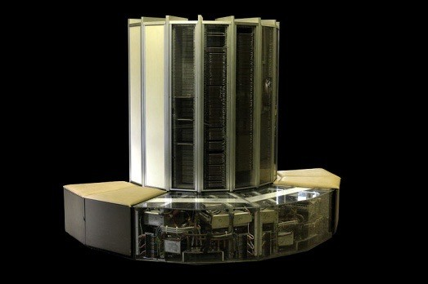
Old Protection Mode: Base & Bound
User processes need to be protected from each other
Two registers, base and bound test whether this virtual address belongs to this process (Built in Cray-1)
If not, a memory protection violation exception is raised
Users cannot change the base and bound registers
bound
P₁
bound
base
P₂
base
Notes:
>>
The base and bounds protection mechanism
safeguards user processes from each other
by defining a contiguous segment of physical memory
for each process using base and bounds registers.
The base register holds the starting physical address of the process's memory segment,
while the bound register specifies the maximum allowable virtual address.
Every memory reference made by a user process is checked against these two registers;
if the virtual address generated by the process falls outside the valid range defined by the base and bound registers,
a memory protection violation exception is raised.
For reference:
The base and bounds protection mechanism relies on hardware to enforce memory protection,
with the operating system (OS) configuring and managing the hardware registers.

Slide 12
Who can change them?
The operating system needs access to the base and bound registers
So, a process that is labeled kernel (also called supervisor or executive) can access any memory location and change the registers
Kernel processes are accessed through system calls, and a return to user mode is like a subroutine return, restoring the state of the user process
Notes:
>>
Users cannot change the base and bound registers.
Q. So, who can change them?
The (OS) requires access to base and bound registers
to manage memory protection and allocation for user processes.
The OS kernel has unrestricted access to all memory locations,
including the ability to modify the base and limit registers.
This access is essential for tasks such as loading and swapping processes in and out of memory.

Slide 13
Segmentation
Basically, multiple base & bounds
– with virtual memory
stack bound
Each segment can be located anywhere in physical memory
stack base
Process
heap bound
heap base
Notes:
>>
Segmentation extends the concept of base and bounds addressing
by applying it to multiple logical segments within a process's virtual address space,
rather than just a single contiguous block.
Each segment (such as code, heap, or stack)
is treated as a separate unit with its own base address and bounds register,
allowing the OS to place these segments independently in physical memory.
enabling more efficient use (of physical memory).

Slide 14
PAGING

Slide 15
The Limits of Physical Addressing
“Physical addresses” of memory locations
A0-A31
CPU
D0-D31
A0-A31
Memory
D0-D31
Simple addressing method of archaic pre-1978 computers
Data
All programs shared one address space: The physical address space
Machine language programs had to be aware of the machine organization
No way to prevent a program from accessing any machine resource in memory
Notes:
>>
The earliest computer systems operated on a memory model that required
memory needed by a given process to be allocated in a single, contiguous region of physical memory.
This approach meant that all programs shared one address space,
which was the physical address space of the machine.
Machine language programs had to be aware of the specific machine organization,
including the physical layout of memory,
because there was no abstraction layer between the program and the physical memory.
As a result,
there was no mechanism to prevent a
program from accessing any machine resource in memory.
This simple addressing method, common in pre-1978 computers,
lacked the protections and abstractions provided by modern virtual memory systems.
(making it difficult to run multiple programs simultaneously without interference.)

Slide 16
Solution: Add a Layer of Indirection
“Virtual Addresses” “Physical Addresses”
A0-A31
CPU
D0-D31
Virtual Physical
Address Translation
A0-A31
Main Memory
D0-D31
Data
All user programs run in a standardized virtual address space starting at zero.
Needs fast(!) Address Translation hardware, managed by the operating system (OS), to map each virtual address to physical memory
Hardware supports “modern” OS features: Memory protection, Address translation, Sharing
Notes:
>>
The solution is virtual addressing,
which introduces a layer of indirection between virtual addresses used by programs and the physical addresses in memory,
enabling each process to operate within a standardized virtual address space starting at zero,
regardless of its actual physical location.
The hardware performs fast address translation for every memory reference,
converting virtual addresses to physical addresses dynamically during runtime.
This translation is managed by the OS,
which sets up and maintains page tables
that define the mappings between virtual pages and physical frames.
Hardware support is essential for key "modern" OS features:
The Memory Management Unit (MMU)
performs address translation from virtual to physical addresses,
using page tables maintained by the OS.
Memory protection is enforced by the MMU through protection bits in page table entries,
which control read, write, and execute permissions,
preventing unauthorized access to memory regions belonging to other processes or the kernel.
The hardware also supports controlled sharing of memory between processes
by allowing multiple page table entries to map to the same physical frame.

Slide 17
Paging Overview
Fully-associative mapping, because page faults are really, really expensive
Page is located using a page table, one entry per page in the virtual address space
– Size is sometimes reduced by hashing, to make one entry per physical page in main memory - an inverted page table
Since locality says that a page will be used multiple times, address translation usually tests the addresses of the recently referenced pages before looking in other places
So, address translation information is held in the translation look-aside buffer (TLB)
Notes:
>>
Demand paging uses fully associative mapping
because page faults are extremely expensive,
making it crucial to minimize miss rates.
For reference:
(demand paging: only load pages as they are needed)
(fully associative mapping: any page can be placed in any available frame within physical memory)
To manage this large associativity efficiently,
a page table is used to locate the frame containing a specific page.
To improve lookup efficiency,
hashing is often used to map virtual addresses to specific entries in an inverted page table.
An inverted page table
reduces memory overhead by maintaining a single system-wide table
with one entry for each physical frame in main memory,
as opposed to a separate page table for each process that
contains an entry for every virtual page in the virtual address space.
Principle of Locality:
Paging requires translating virtual addresses to physical addresses,
which can incur significant overhead if done for every memory access.
Since programs tend to access the same pages repeatedly within a short time,
the principle of locality of reference is leveraged,
through a specialized hardware cache called the Translation Lookaside Buffer (TLB).
The TLB acts as an address-translation cache,
storing mappings from the page table to avoid repeated,
slow page table lookups.

Slide 18
Paging Overview (cont.)
Most machines replace the LRU page
– moving pages between memory and disk is so slow that it’s worth doing something close to real LRU
Disks are so slow that machines use write-back, not write- through, and keep a dirty bit for each page
Notes:
>>
In most machines,
the least recently used (LRU) page is replaced during paging to manage memory efficiently.
Moving pages between memory and disk is extremely slow,
making it worthwhile to implement approximations of true LRU.
(rather than the ideal but impractical perfect LRU)
Cache write policy:
Due to the high latency of disk access,
systems use write-back caching instead of write-through,
(meaning data is only written to disk when the page is replaced)
… and maintains a dirty bit for each page that indicates
whether the page has been modified since it was loaded into memory

Slide 19
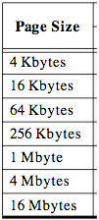
Page tables encode virtual address spaces
A virtual address space is divided into blocks
of memory called pages
Virtual Address Space
Physical Address Space
frame
frame
frame
frame
A machine usually
supports pages of a few sizes (MIPS R4000):
A valid page table entry encodes physical memory “frame” address for the page
Notes:
>>
A virtual address space is divided into fixed-size blocks of memory called pages.
While there is a default page size on many systems,
different OSs usually supports several page sizes.
A page table encodes virtual address spaces
by mapping virtual pages to physical memory frames.
A valid page table entry encodes the physical memory “frame” address corresponding to a virtual page,
enabling the translation of virtual addresses to physical addresses.

Slide 20
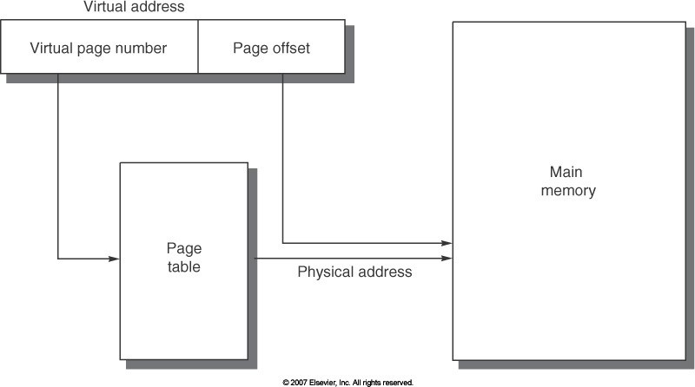
Page Tables (Figure B.23)
Notes:
>>
This diagram illustrates the mapping of a virtual address to a physical address via a page table.
A virtual address is divided into a virtual page number and page offset.
The virtual page number is
used to index into the page table to find the corresponding physical page number.
The page offset
requires no translation and is directly mapped to the physical address.

Slide 21
Details of Page Table
Page Table
Physical
Memory Space
Virtual Address
frame
frame
frame
frame
12
V page no.
offset
Page Table
V | Access Rights | PA
Page Table Base Reg
index into page table
virtual address
table located in physical memory
P page no.
offset
12
Physical Address
Page table maps virtual page numbers to physical frames (“PTE” = Page Table Entry)
Virtual memory => treat memory ≈ cache for disk
Notes:
>>
A page table is used to map virtual page numbers to physical frame numbers,
with each mapping stored as a page table entry (PTE).
Virtual memory works
by treating main memory (DRAM) as a cache for secondary storage (e.g., disk),
enabling efficient memory management
and allowing processes to use more memory than physically available.

Slide 22
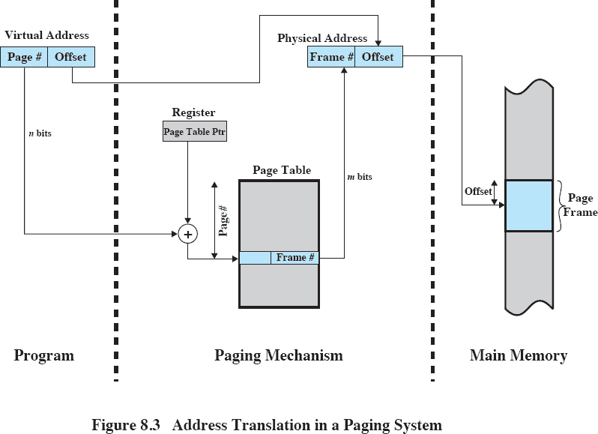
Use of Page Table – another view
(Process)
(From William Stallings)
Notes:
>>
Each process maintains its own independent page table.
Paging mechanism:
The base address of the current process's page table is
held in the Page Table Base Register (PTBR),
(A Page Table Length Register (PTLR) indicates the number of entries in the table.)
During address translation,
the Memory Management Unit (MMU) uses
the page table to convert a logical address generated by the CPU into a physical address.
To locate the correct page table entry,
the hardware calculates the address of the entry
by multiplying the virtual page number
with the size of a page table entry
and adding it to the base address stored in the Page Table Base Register.
The physical address is then calculated by combining the physical frame number with the offset.
This is done by shifting the frame number left by the number of bits in the offset and adding the offset.

Slide 23
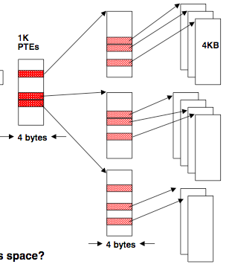
Two-Level Page Tables
Each process needs its own address space!
Two-level Page Tables
32-bit virtual address
22 21 12 11
31
0
P1 index | P2 index | Page Offset
Top-level table wired in main memory
Subset of 1024 second-level tables in main memory; rest are on disk or unallocated
Notes:
>>
A two-level page table
can be used to manage virtual memory more efficiently
by reducing the memory overhead
when compared to a single-level table.
The two-level structure allows the OS to allocate only
the necessary page table entries for the pages a process needs,
rather than reserving space for the entire virtual address space.
(Go over example)
32-bit virtual address:
10-bit index for the outer table
10-bit index for the inner tables
12-bit page offset
2^10 = 1024 second-level tables …

Slide 24
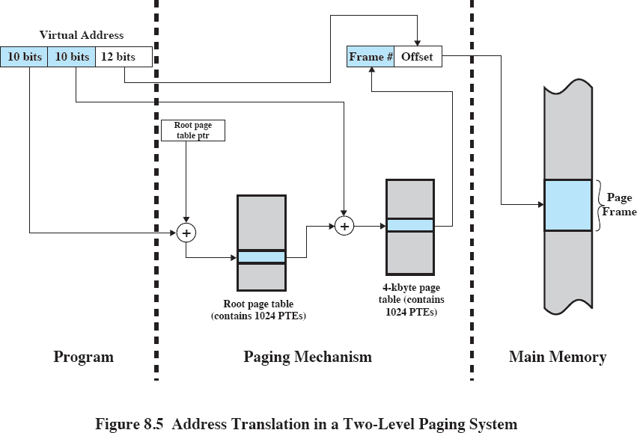
Hierarchical Paging System – Another View
(Process)
(From William Stallings)

Slide 25
Choosing page size
A large page size
  keeps page table small
  reduces cache miss times, if accesses have locality
  reduces start-up overhead in moving data from disk to memory
  means fewer TLB misses
but also
  wastes memory (internal fragmentation)
  increases the time to start up a program
Notes:
>>
The size of the page table is inversely proportional to the page size.
A large page size reduces the number of entries in the page table, which
keeps the page table small
reduces cache miss times
reduces start-up overhead in moving data from disk to memory
and fewer TLB misses (as the number of TLB entries is restricted)
improving performance for memory-intensive applications.
However, larger page sizes
increase internal fragmentation
(where unused space within a page is wasted)
and can lead to longer program startup times
(if the initial memory allocation is not efficiently matched to the actual data size)

Slide 26
VM and Disk: Page replacement policy
Dirty bit: page written.
Page Table
dirty used
Used bit: set to 1 on any reference
1 | 0 | ...
1 | 0
0 | 1
1 | 1
0 | 0
Set of all pages in Memory
Tail pointer: Clear the used bit in the
page table
Freelist
Head pointer
Place pages on free list if used bit
is still clear. Schedule pages
with dirty bit set to be written to disk.
Hardware Architect’s role: support setting dirty and used bits
Free Pages
Notes:
>>
A page replacement policy
determines which page to evict
when a new page must be loaded
and no free frames are available.
The primary goal is to minimize page faults.
Hardware support for
a dirty bit (which is set when a page is modified)
and a use (or reference) bit (which is set when a page is accessed)
is used for page replacement such as a LRU approximation.
To optimize performance,
systems maintain a free page pool for frames
that are clean and available for immediate use.
When a page is evicted and is clean,
it is placed on the free list;
if it is dirty, it is scheduled for writing to disk.
Head pointer:
The head pointer tracks the next frame to examine during replacement.
If a page's use bit is still clear when it is considered for replacement,
it is placed on the free list,
indicating it has not been recently accessed.

Slide 27
VIRTUAL MEMORY
- APPENDIX B / CHAPTER 2

Slide 28
MIPS Address Translation: How does it work?
“Virtual Addresses” “Physical Addresses”
A0-A31
CPU
D0-D31
Virtual Physical
Translation Look-Aside Buffer (TLB)
A0-A31
Memory
D0-D31
Data
Translation Look-Aside Buffer (TLB)
A small, fully-associative cache of mappings from virtual to physical addresses
TLB also contains protection bits for virtual address
Fast common case: Virtual address is in TLB, process has permission to read/write it.
Notes:
>>
In the MIPS architecture,
virtual address translation is managed
by the Memory Management Unit (MMU)
using the Translation Lookaside Buffer (TLB),
The TLB is a small, fast cache that stores recently used virtual-to-physical address mappings,
which acts as a specialized cache for page table entries,
enabling rapid translation without accessing slower main memory.
TLB Control bits:
The TLB also stores control bits for each entry, including valid, dirty, and cacheability bits,
which provide protection and management information.
These bits determine if a process has permission to read or write the mapped page, and whether the page is cached.

Slide 29
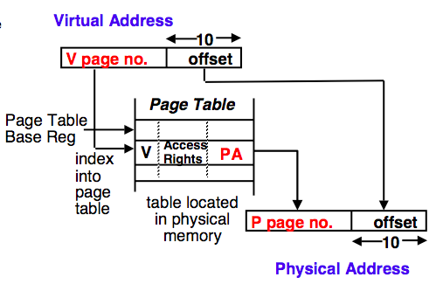




The TLB Caches Page Table Entries
Physical and virtual pages must be the same
size! Here, 1024 Bytes/page each.
Physical frame address
virtual address page offset
for current
AddrSpaceID
V
Page Table
2
0
1
3
TLB caches page table entries.
V=0 pages reside on disk or have not yet been allocated to this ASID.
OS handles V=0 as a “Page fault”
physical address frame offset
TLB
Vadd
PAdd
frame page
2 | 2
0 | 5
Notes:
>>
How it works:
When a process accesses a virtual address,
The CPU first checks the TLB for a matching entry using
the Virtual Page Number (VPN)
and the Address Space Identifier (ASID)
to ensure the mapping belongs to the current process.
An Address Space Identifier (ASID)
is a unique identifier used by a processor to
distinguish between the virtual address spaces of different processes or tasks.
If a valid entry is found (a TLB hit),
the physical address is derived by combining
the Physical Page Number (PFN) from the TLB entry
with the page offset from the virtual address,
allowing immediate access to the correct physical memory location.
If the required mapping is not in the TLB (a TLB miss),
the system performs a page table walk to find the translation in main memory,
updates the TLB with the new entry,
and then restarts the original instruction.
Optional:
This process is fast and efficient, with a high hit ratio expected,
often between 0.95 and 0.99, due to the principle of locality.

Slide 30
Common Organization
CPU
TLB
Even a cache
L1 Cache
hit requires TLB translation
Write Buffer
first!
L2 Cache
Memory bus
Notes:
>>
Even when a cache hit occurs, the TLB translation is still required first.
The TLB acts as a cache for page table entries,
translating virtual addresses to physical addresses before the cache lookup can proceed.
This is because the cache,
needs the physical address to perform its lookup.
Optional:
The TLB is typically implemented as a direct-mapped or set-associative structure,
though it functions similarly to a cache,
with entries being replaced when the buffer is full,
often using a least recently used (LRU) policy.

Slide 31
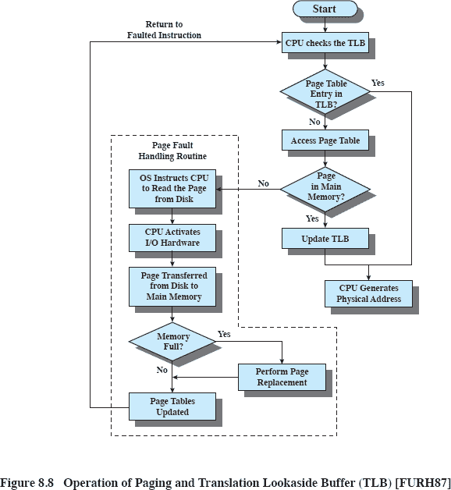
Translation Lookaside Buffer – Another view
(From William Stallings)
Notes:
(Explain the diagram.)

Slide 32
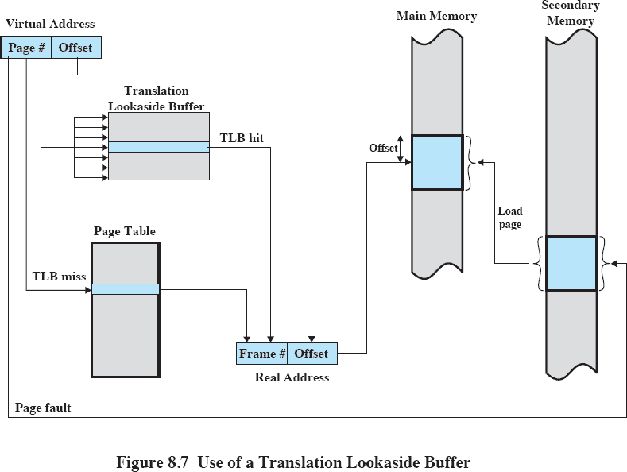
TLB – Another view (cont.)
(From William Stallings)

Slide 33
Can TLB translation overlap cache indexing?
Rationale:
– Improve performance by overlapping cache access
and TLB lookup
Notes:
>>
A key performance optimization in modern processors,
is that the TLB translation can overlap with cache indexing.

Slide 34






Can TLB translation overlap cache indexing?
{Maybe if cache is tiny.}
Virtual Page Number | Page Offset
Tag Part of Physical Addr = Physical Page Number | Index | Byte Select
Virtual
Translation Look-Aside Buffer (TLB)
Physical
Cache Tags
Valid
Cache Data
Cache Block
Cache Block
Cache Tag
=
Having cache index in page offset works, but
Q. What is the downside?
A. Inflexibility. Size of cache limited by page size.
Hit
Data out
Notes:
(A key performance optimization in modern processors,
is that the TLB translation can overlap with cache indexing.)
>>
This is achieved through a virtually-indexed, physically-tagged (VIPT) cache design,
where the lower bits of the virtual address (the page offset)
are used to index the cache before the full physical address is known,
allowing the cache lookup to proceed in parallel with the TLB translation.
For example,
consider a system with a 4 KB page size,
which requires 12 bits for the page offset
(since 2^12 = 4096 bytes).
If a virtual address is 0x1804,
the lower 12 bits (0x804) represent the page offset
and are used directly to index the cache.
The remaining higher bits of the virtual address form the virtual page number (VPN),
which is used to look up the translation in the TLB or page table
to obtain the physical page number (PPN).
Once the PPN is determined,
it is concatenated with the unchanged page offset to form the full physical address.
Question:
Having cache index in page offset works, but
Q. What is the downside?
A. Inflexibility. Size of cache limited by page size.

Slide 35
Problems With Overlapped TLB Access
Overlapped access (faster) works only if the address bits used to index into the cache do not change as the result of VA translation
This usually limits overlapping to small caches, or large page sizes, or high n-way set associative caches if you want a large capacity cache
Example: suppose everything the same except that the cache is increased to 8 KB instead of 4 KB:
11 2
cache index
00
20
 | 12
virt page # | disp
This bit is changed
by VA translation, but it is needed for cache lookup.
Solutions:
Go to 8 KB page sizes
SW guarantee VA[13]=PA[13]
Go to 2-way set associative cache;
4
4
1K
2-way set assoc cache
10
Notes:
…
For this example:
When the cache size increase from 4 KB to 8 KB,
the index size increases from 10 to 11 bits.
This bit is changed by virtual address translation
Solution:
To maintain index alignment with the page offset
the cache must become 2-way set associative.

Slide 36
Can CPU use virtual addresses for cache?
“Virtual Addresses” “Physical Addresses”
A0-A31
CPU
D0-D31
Virtual Physical
Translation Look-Aside Buffer (TLB)
A0-A31
Main Memory
D0-D31
Virtual
Cache
D0-D31
If cache index in virtual address, only cache misses use TLB!
Downside: a subtle, fatal problem:
Synonym problem (Aliasing)
– If two (virtual) address spaces share a physical frame, data may be in cache twice. Maintaining consistency is a nightmare.
Notes:
>>
If the CPU use virtual addresses for indexing cache,
the TLB is only accessed when a cache miss occurs.
However, there is a downside:
…

Slide 37
Advantages of Paged Virtual Memory
Translation:
  Program can be given consistent view of memory, even though physical memory is scrambled
  Only the most important part of program (“Working Set”) must be in physical memory.
  Contiguous structures (like stacks) use only as much physical memory as necessary yet still grow later.
Protection:
  Different threads (or processes) protected from each other.
  Different pages can be given special behavior
» (Read Only, Invisible to user programs, etc).
  Kernel data protected from User programs
» Very important for protection from malicious programs
Sharing:
  Can map same physical page to multiple users (“Shared memory”)
Notes:
>>
The advantages of paged virtual memory can be divided into three categories.
Translation
Protection
Sharing
…

Slide 38
Summary - TLB, Virtual Memory
Page tables map virtual address to physical address
TLBs are important for fast translation
TLB misses are significant in processor performance
  Most systems cannot access all of 2nd level cache without TLB misses! The answer in newer processors is 2-levels of TLB.
Questions to understand Caches, TLBs, VM:
  Where can a block be placed?
  How is a block found?
  What block is replaced on a miss?
  How are writes handled?
Today, virtual memory (VM) allows many processes to share single memory without having to swap all processes to disk. Virtual memory protection is maybe even more important than memory hierarchy benefits, but computers are still insecure
Notes:
…
TLB misses:
The introduction of two-level TLBs
typically, an L1 TLB for fast lookups
and an L2 TLB to handle misses from the L1
has become standard in modern microarchitectures.
Questions …
Today, Virtual memory …
… but computers are still insecure …
because virtual memory does not eliminate all vulnerabilities such as
software bugs,
privilege escalation flaws,
or attacks exploiting hardware-level weaknesses

Slide 39

Review Question
Page size: 8KB
Width of Virtual Page Number: 30 bits
Width of Physical Frame Number: 20 bits
3 admin bits in the single-level page table
What is the length of a virtual address?
Notes:
>>
The length of the virtual address is determined by the sum of the bits used for the virtual page number and the bits used for the page offset.
Page size: 8KB = 2^13 bytes
Page offset: 13 bits
VPN: 30 bits
Virtual address: 30 + 13 = 43 bits

Slide 40
Review Question
Page size: 8KB
Width of Virtual Page Number: 30 bits
Width of Physical Frame Number: 20 bits
3 admin bits in the single-level page table
What is the length of a physical address?
Notes:
PFN: 20 bits
Frame offset: 13 bits
Physical address: 20 + 13 = 33 bits

Slide 41
Review Question
Page size: 8KB
Width of Virtual Page Number: 30 bits
Width of Physical Frame Number: 20 bits
3 admin bits in the single-level page table
How many entries in the page table?
Notes:
>>
The number of entries in the page table is determined by the width of the virtual page number.
VPN: 30 bits
Number of entries: 2^30

Slide 42
Review Question
Page size: 8KB
Width of Virtual Page Number: 30 bits
Width of Physical Frame Number: 20 bits
3 admin bits in the page table
How wide each page table entry (in bits)?
(assume single- level page table)
Notes:
>>
The width of each page table entry is determined by the sum of the bits required to store the physical frame number and the bits required for administrative (metadata) purposes.
PFN: 20 bits
3 admin bits
Page table entry size: 23 bits

